Slide 1


St. MARTIN’S ENGINEERING COLLEGE
UGC Autonomous
NBA & NAAC A+ ACCREDITED
Dhulapally, Secunderabad– 500100
Department of Artificial Intelligence and Data Science
AI-Powered Personal Finance Advisor with Risk Analysis
Batch No: 17
1. POLKAM JAI KARTHIK (24K85A7204)
2. NAGANDLA DHEERAJKUMAR (23K85A7244)
3. REDROWTHU CHAITANYA SAI (23K85A 7254)
Under the Guidance of
Mrs.B.Chandra Rakhee Assistant Professor Department of Artificial Intelligence and Data Science

Slide 2
OUTLINE
Abstract
Introduction
Existing System
Proposed System
Applications
Software Requirement
Project Architecture
Split of modules
Code implementation
References

Slide 3
ABSTRACT
AI-powered finance advisor for personalized financial planning.
Analyzes income, expenses, savings, and investment goals.
Uses AI-driven risk assessment for market trends and investment strategies.
Adapts to financial changes using machine learning models.
Provides real-time insights and portfolio tracking.
Cost-effective and accessible for individuals and small businesses

Slide 4
INTRODUCTION
Managing money is important for a stable future. Traditional methods, like using spreadsheets or hiring advisors, are expensive, slow, and not personalized. Many platforms give general advice that does not fit individual needs. AI makes financial planning easier and smarter by analyzing data, checking risks, and giving real-time, personalized suggestions. The proposed system will help users plan investments, track expenses, and improve savings using machine learning. Key Points: Traditional financial planning is slow, costly, and not personalized.
AI helps by analyzing data and giving smart, real-time advice.
The system makes money management easy and effective

Slide 5
EXISTING SYSTEM
Manual methods: Spreadsheets, basic calculators.
Human-driven financial advisors: Costly and time-consuming.
Generic investment platforms: Lack of personalization and real-time risk analysis.
Disadvantages:
High dependency on manual work and human advisors.
Limited personalization based on user-specific risk tolerance.
No real-time risk assessment or market insights.

Slide 6
PROPOSED SYSTEM
AI-driven finance advisor for personalized recommendations.
Machine learning-based risk analysis for market volatility and user profiles.
Visualization tools for financial tracking and portfolio performance.
Advantages:
Personalized financial strategies.
Real-time risk assessment and investment insights.
Automated portfolio tracking.
Cost-effective and accessible.
Promotes financial literacy with clear insights.

Slide 8
APPLICATIONS
Individuals:
Personalized investment plans and risk assessment.
Budget tracking and savings strategies.
Small Businesses:
Financial planning and investment management.
Cash flow analysis and forecasting.
Financial Advisors:
AI insights to support advisory services.
Real-time market updates and risk analysis.
Education:
Tools for teaching personal finance.
Interactive financial literacy modules.
Banks:
Portfolio analysis and personalized recommendations.

Slide 9
SOFTWARE REQUIREMENTS
Development Tools:
Python 3.8+, Flask/Django for backend, ReactJS/Streamlit for frontend.
AI Models:
ML models (Random Forest, XGBoost) for risk analysis.
NLP models for financial news analysis.
Libraries:
NumPy, Pandas for data handling, Matplotlib/Plotly for visualization.
Scikit-learn for model training and evaluation.
Data Sources:
Market data APIs (Alpha Vantage, Yahoo Finance).
User financial inputs stored securely.
Database:
SQLite/PostgreSQL for storing financial insights.

Slide 10
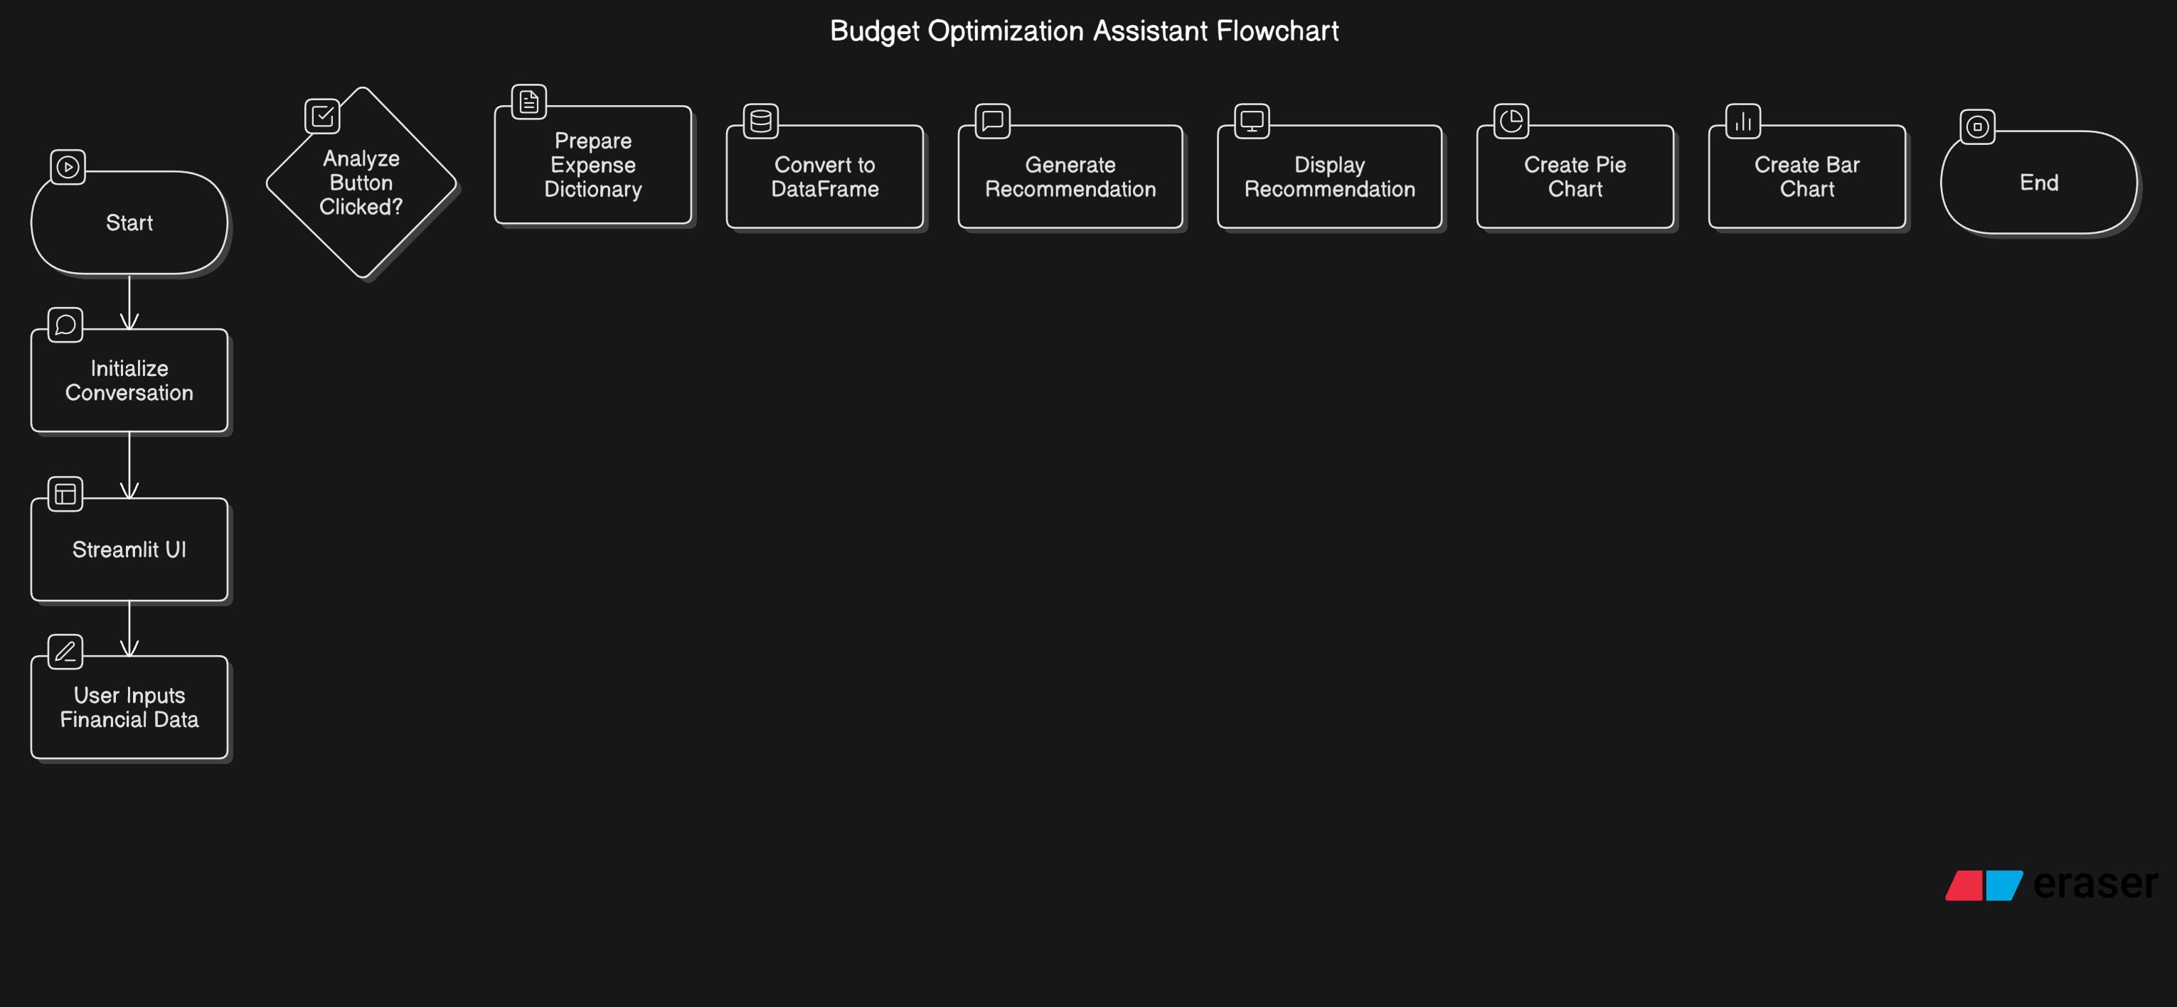
PROJECT ARCHITECTURE

Slide 11
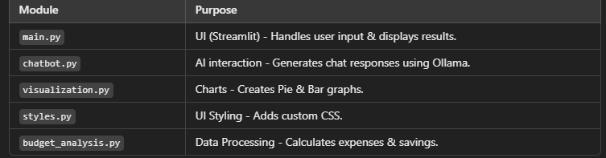
SPLIT OF MODELS

Slide 12
CODE IMPLEMENTATION
import streamlit as st
import pandas as pd
import matplotlib.pyplot as plt
import ollama
from collections.abc import MutableMapping
# Initialize conversation
convo = []
# Function to handle chat responses from the model
def stream_response(prompt):
convo.append({'role': 'user', 'content': prompt})
response = ''
stream = ollama.chat(model='llama3.1:8b', messages=convo, stream=True)
for chunk in stream:
response += chunk['message']['content']
convo.append({'role': 'assistant', 'content': response})
return response

Slide 13
# Custom CSS for a beautiful UI
st.markdown("""
<style>
.reportview-container {
background: #f0f4f7;
}
.title {
font-size: 45px;
color: #4A90E2;
text-align: center;
padding-bottom: 20px;
font-family: 'Montserrat', sans-serif;
}
.header {
font-size: 24px;
color: #333;
padding-top: 10px;
font-family: 'Montserrat', sans-serif;
}
.stButton>button {
background-color: #4A90E2;
color: white;
font-size: 16px;
padding: 10px 20px;
border-radius: 10px;}
}

Slide 14
QUERIES ??

Slide 15
THANK YOU

